Slide 1


Let Data Decide Your Next Destination
By Kevin Angotti

Slide 2

Introduction:
Travel is a billion-dollar industry, and the hospitality sector takes a large portion of the revenue. Airbnb has quickly become a staple in the travel sector. With their bookable locations in just about every travel destination worldwide, you can easily see why they have become so successful. This project looks to finding ways a customer can locate the best host to book based on location and affordability.

Slide 3

Research Questions:
Which hosts are the busiest in the San Francisco area?
Does the price of the booking have a correlation between reviewing rating?
What determines if a host is successful?
Are there one or more variables that predict if a host gets booked?
Do hosts with instant booking available produce more booking?

Slide 4

Methods:
For my project, I will utilize various predictive analytics methods to understand relationships within the data and identify factors that would allow a person to search through a booking site to help narrow the choices of locations based on specific search criteria. Key factors examined during the project were price, location, host, number of properties, number of reviews, and if the customer could book properties via the instant book option.
The approach to this method was to utilize the R and Python programming languages and Power BI.
Programming was used to clean the dataset, create initial visualizations, and build prediction models for the analysis.
Power BI was used to create a dashboard that could be converted into a plugin application, which could be added to sites like Google or any mainstream booking sites.

Slide 5

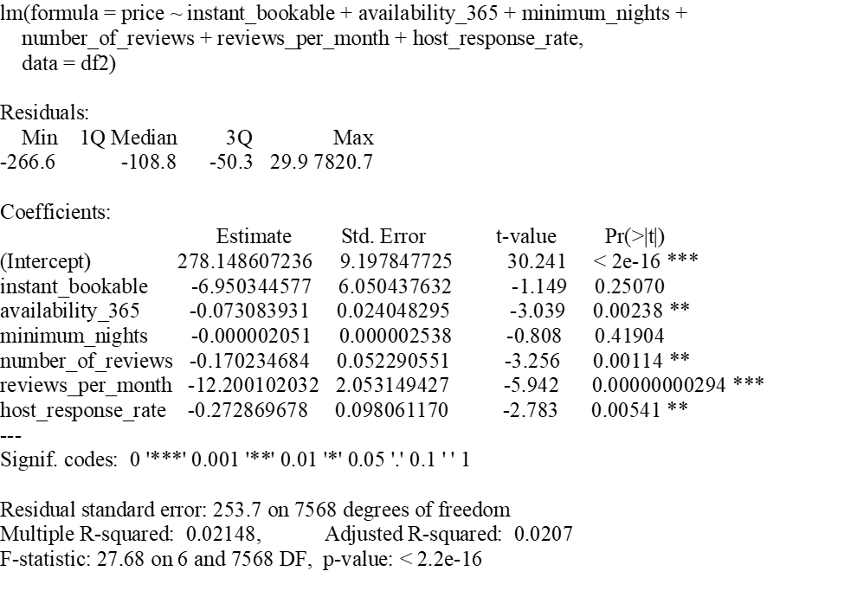
Modeling:
Using the R programming language, I created a quick linear model of the key variables attempting to see any significance.
Even with R-squared low, there still seems to be some importance between availability, reviews, and price. Only minimum nights and instant booking were about a p-value of 0.05.

Slide 6
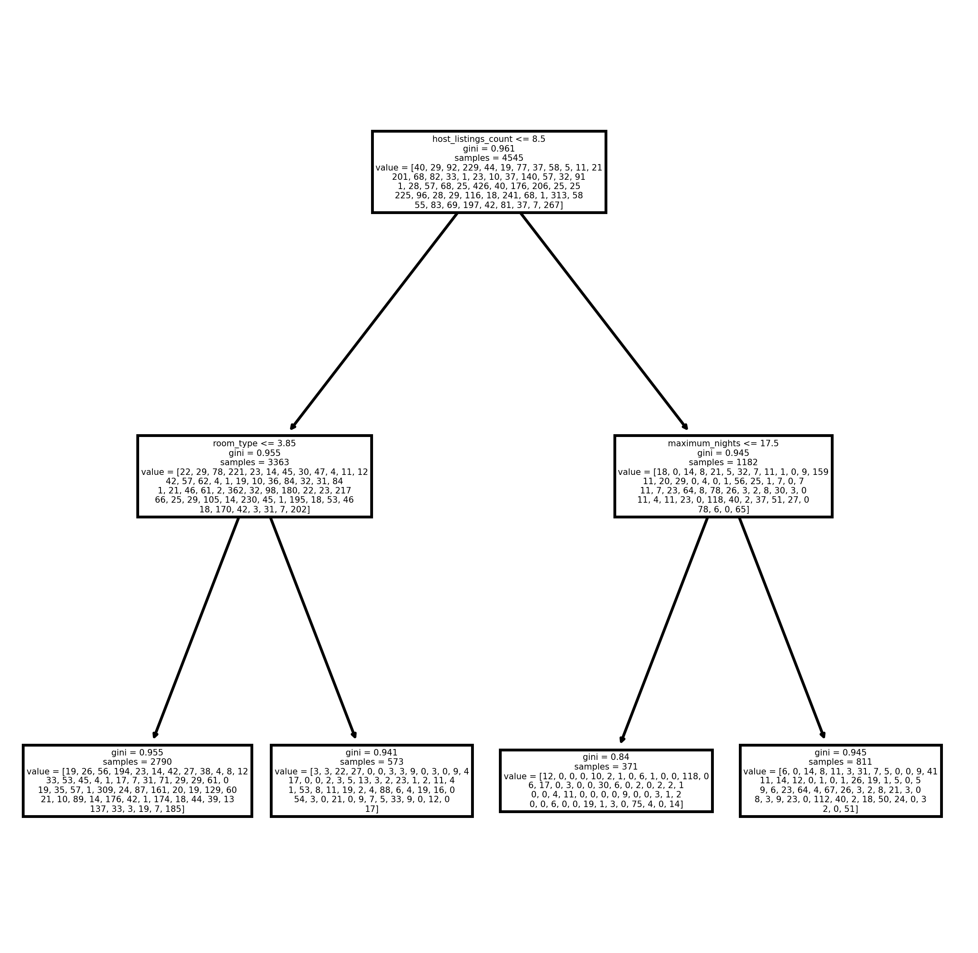
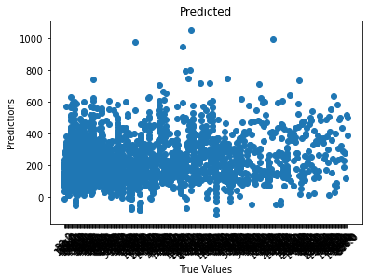
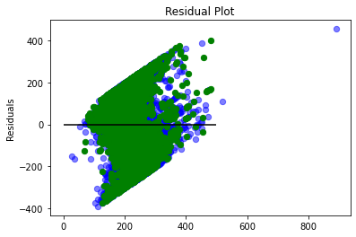
Modeling Cont.
Next, I shifted to Python to create more in-depth linear models. I was also able to create a K-Modes clustering model and a Decision Tree, which allowed me to run multiple models over the entire dataset at once.
The first liner model I ran in Python with price as the target returned a score between 26 and 31 percent for accuracy using the standard 60/40 train, test, split. The results gave the neighborhood predicted for price.
A second LM model returned the means squared error (MSE), also taking price as a target. This linear model is meant to help determine the amount of skew within the dataset. Here the returned MSE was 25349.17, which was extremely high. I determined this could be based on the input value of host id since this is a very large 10-digit number compared to that of price.
The K-Means clustering model otherwise known as K-Modes, is a model that handles categorical data very well. Since there are numerous variables with categorical values like neighborhood and location address the model can take in an entire dataset and returned its prediction on each cluster's most common outcome. These results each time the model ran returned 5 clusters; 3 of which were houses while the other two apartments. An observation I noticed was none of the clusters returned were private rooms, which was a large portion of the dataset. Most model runs returned a price range of $100 to $150 on specified neighborhoods.
The last model I conducted was a Decision Tree. These are good for narrowing down particular predictions based on desired inputs. Though the tree is hard to read, the results were determined to be positive. The decision tree as seen pictured top left, was set up to predict a neighborhood that is best suited for the customer's criteria. The first node or top of the tree, a host with more than 8.5 listings would move you to the right second level of the tree; the second node on the right asks if the customer wanted to stay more than 17.5 nights. Depending on the answer here, the tree's leaf or terminal node bottom of the tree provides differing results with a predicted number of host locations from a particular neighborhood based on price, review rating, host response, and number of reviews and their rating.

Slide 7

Conclusion:
In the key variable’s some of the insights, I found reveled that on average price for the San Francisco area was around $215, with a $469 security deposit and $108 for cleaning fees which included 2 guests per stay. Average review was 95%, and each host had around 20 properties/listings. Hosts were also reviewed roughly 2 times per month, and a host's response rate was about 95%.
The research paper that accompanies this project discusses how the results can be used in a plugin tool or application which could help customers locate their next Airbnb stay via helpful analytic search's.
The attached Power BI brings some of this concept to life. Please follow me over to the Dashboard for some of the helpful tools that could be implemented.mplemented into a travel site.

